Slide 1

Graph Neural Networks Theory and Application

Slide 2
Lets start from the Basics
Graphs and basic definitions

Slide 3
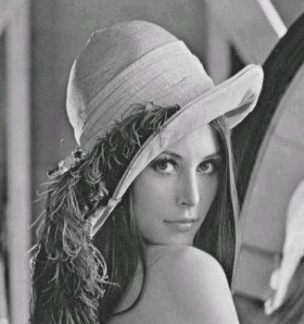
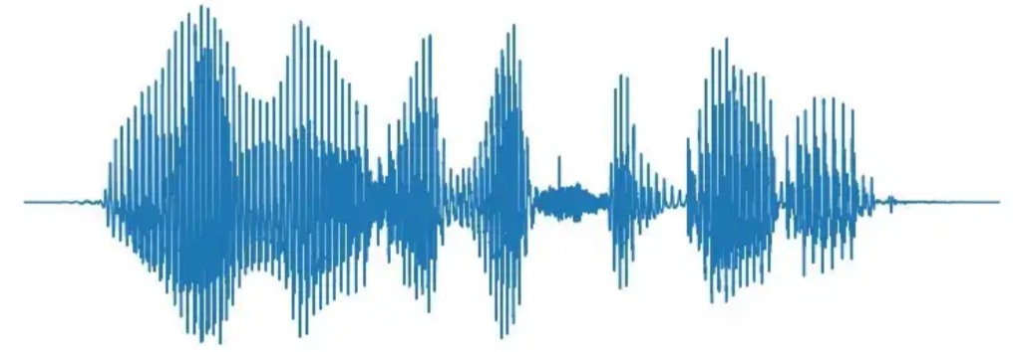
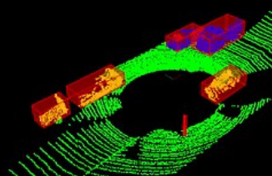
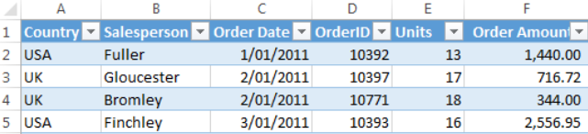




Structured Data
Structured Data has a specific positional format to describe them.
$ℝ↦ ℝ$ : Signal , Speech etc.
$ℝ^{2}↦ ℝ$ : Images
$ℕ↦X$ : Tabular data
$ℝ^{3}↦ ℝ^{n}$ : Point clouds, Volumes
Notes:
Structured data can be unambiguously described with a positional vector. These position vectors can be real valued scalars as in speech and signal or they could be 2d vectors describing a image or they could be 3d vectors describing point clouds generated from LiDAR cameras or DICOM 3d image volumes generated from CT scans. While those example contains homogeneous data , structured data are not limited to them. They can contain heterogenous data as well as in the case of tabular data.

Slide 4
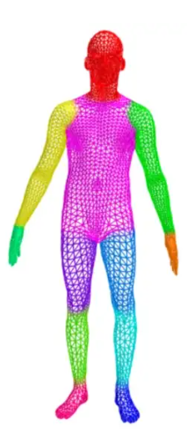
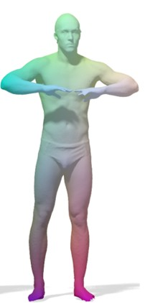
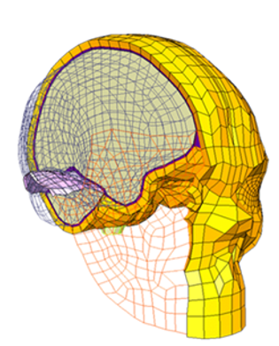
Unstructured Data
Unstructured data doesn’t have a specific position format.
Volumetric Meshes
Surface Meshes
Notes:
Compared to image data 2d pixels become boxes , images has regular structure – a certain number of neighbors - but here it can be different from one to another and the edges are identical in images but here they can have different weights etc.

Slide 5
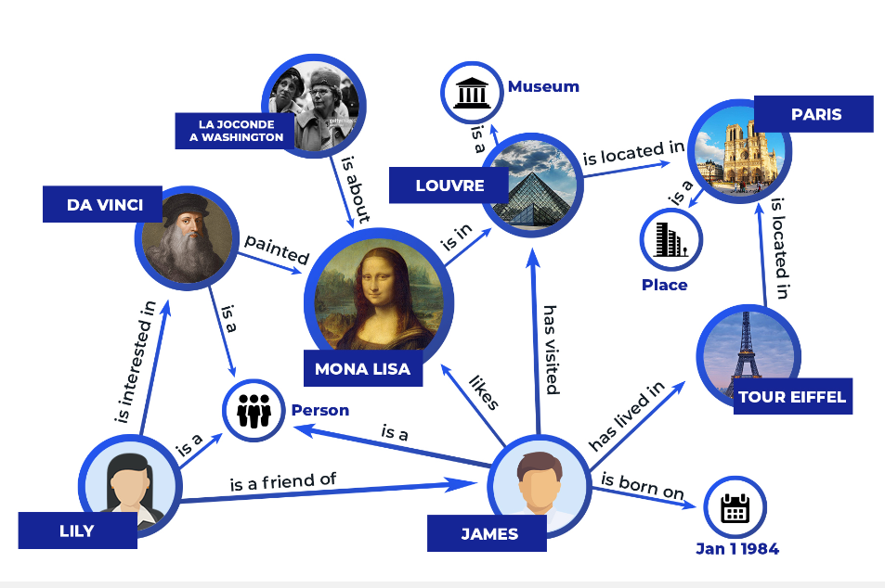
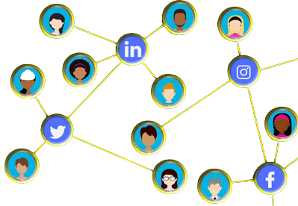
Unstructured Data
Graph structured data the most popular unstructured data type today.
Knowledge Graph
Social Networks
Notes:
Graph structured data includes abstract graphs like knowledge graphs, social media network that contains relations between different objects, spatial graphs like molecules and road networks, temporal graphs [give an example] and spatio-temporal graphs like connectivity graphs of large crowds of people.

Slide 6
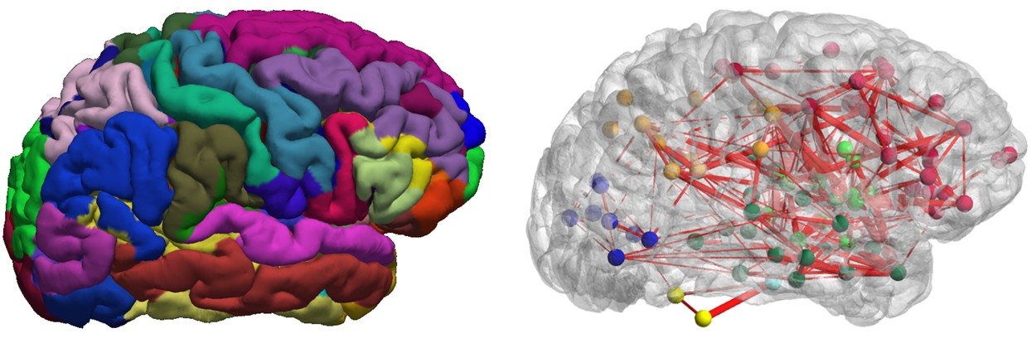
Graph structure usage
Graphs can be used to model brain connectomes taken from fMRI/DTI data

Slide 7
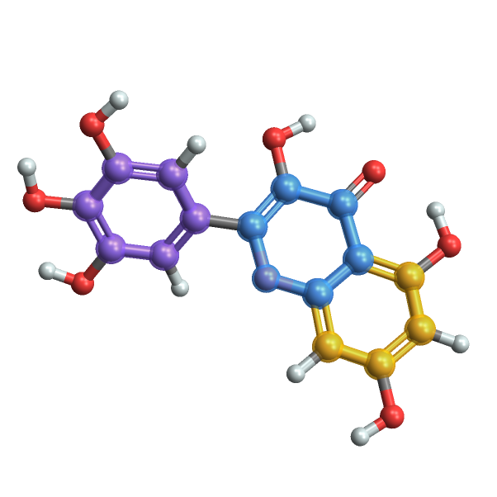
Graphs are also used in chemistry and Pharmacy
Modeling molecules as graphs data, they can be used with graph neural networks to do
Molecule Analysis
Drug discovery
Drug repurposing

Slide 8
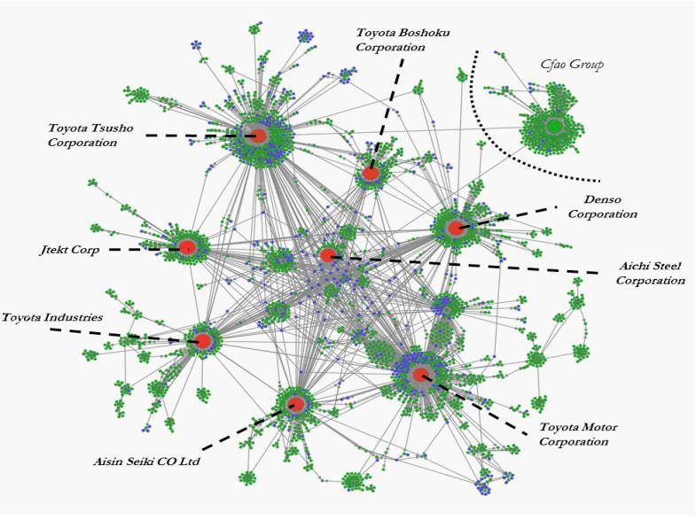
In financial sector, graphs can be used to model how the markets work as in the case of stock market prediction.

Slide 9





How do we define a graph?
A graph $G(V,E)$ is mathematical object defined by a set of nodes V and set of edges E. For example lets take a look at the following graph.
Here the graph G1 = (V1,E1) where,
V1 = { A, B, C, D} & E1 = {{A,B},{B,C},{D,A}}
It important to note that this defines a special type for graph called undirected graphs, which are graphs having undirected edges, meaning edge A,B or B,A mean the same as the edges don’t have a direction.

Slide 10
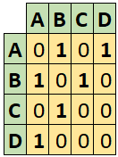

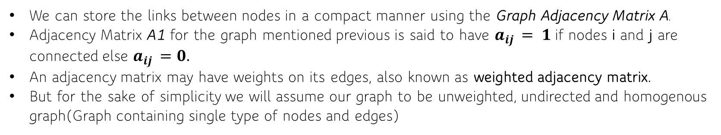
Adjacency Matrix
We can store the links between nodes in a compact manner using the Graph Adjacency Matrix A.
Adjacency Matrix A1 for the graph mentioned previous is said to have $a_{ij }= 1$ if nodes i and j are connected else $a_{ij }=0$.
An adjacency matrix may have weights on its edges, also known as weighted adjacency matrix.
But for the sake of simplicity we will assume our graph to be unweighted, undirected and homogenous graph(Graph containing single type of nodes and edges)

Slide 11
Graph Neural Networks
Part 1

Slide 12
Graph Machine Learning Task
Based on the aspect of the graph we are looking at we can categorize the Graph ML task into 3 categories
Node-level tasks : Here we apply graph neural networks to learn to perform on node-level task such as fraud user detection, community detection etc..
Edge-level tasks : Here the model learns to perform on edge-level tasks like link prediction (whether two users can be friends in social networks) or fraudulent transaction detection.
Graph-level tasks : Here a model learns a representation on the entire graph and performs graph-level tasks like molecule property prediction, drug discovery etc..

Slide 13
Representational Learning
One common denominator all the tasks in the previous slide have is finding representations for nodes or edges or the entire graphs.
This of course isn’t new to machine learning, after all, machine learning is dominated by representational learning.
Models such as Convolutional Neural Network(CNN), Word2Vec (Skipgram, CBOW models), transformers have been doing this under the hood.

Slide 14
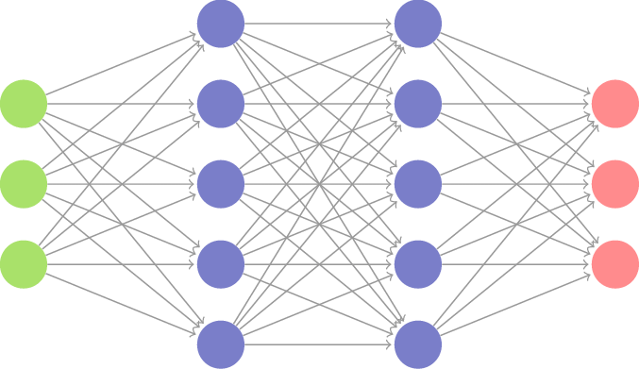
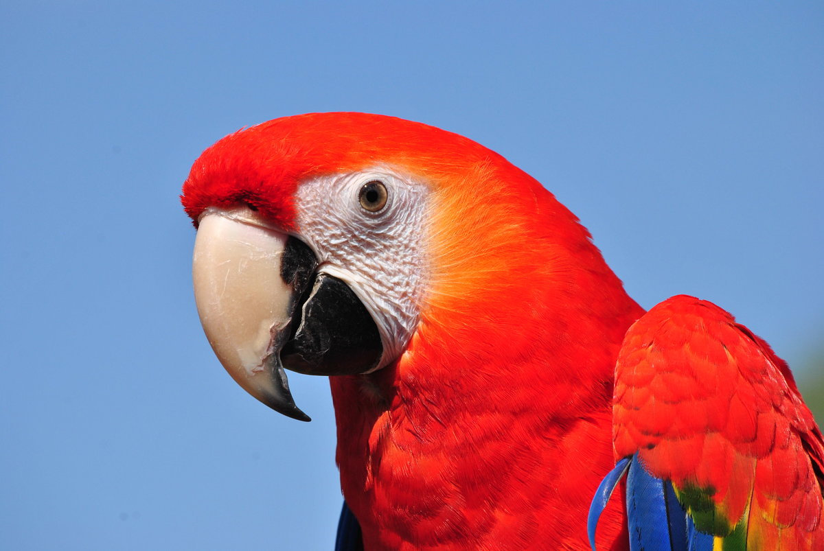
Images
0.23
0.345
.
.
.
0.64
Parrot 0.98
CNN
Dog 0.01
Cat 0.01
Unstructured data
Embedding Space
Passed into MLP for downstream tasks like classification/regression
Text
0.317
-0.45
.
.
.
0.492
Positive 0.98
Word2Vec
“Good”
Negative 0.01
Neutral 0.01

Slide 15
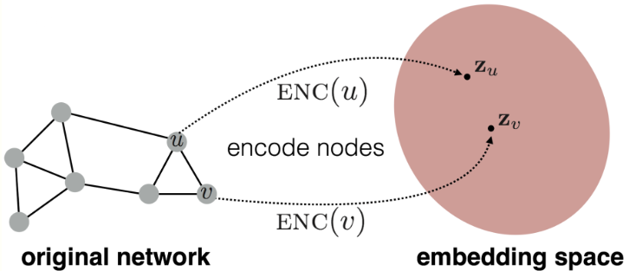
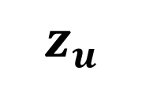
Same is required for Graph Machine Learning
We plan to do the same for graphs as well, Graph Neural Networks(GNN) is a tool to achieve this.
We have a graph and we find a representation for nodes/edges/graph
Take the embedding, in this case a node embedding
Perform down stream task
$$z_{u}$$
Image source : https://snap-stanford.github.io/cs224w-notes/machine-learning-with-networks/node-representation-learning

Slide 16
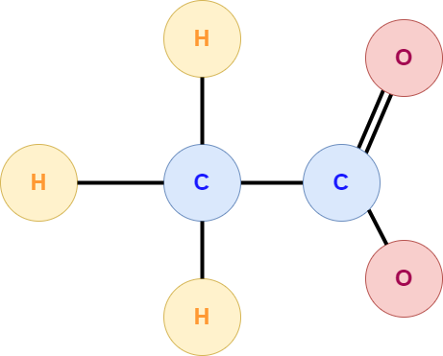
Graphs may have features as well
The graphs we come across in real-life have features present in nodes/edges/graphs or in all combination (ie : present in nodes and edges or nodes and graph level etc..).
1
1.008
1
Atomic number: 8
Atomic weight: 15.99g.mol-1
Valency : 2
Graph Level Properties
Organic: Yes
Flammable: Yes
Corrosive: Yes
Molecular Weight: 60.05
6
12.011
4
1
14
1
20
2
39
1
1.008
1
6
12.011
4
1
14
1
1
1
60.05
1
14
1
39
1
1.008
1
8
15.99
2
Notes:
Acetic acid
But our method of approach remains the same

Slide 17
Graph Neural Networks
Part 2

Slide 18
Graph Neural Networks
Our method should utilize the bias of graph structures as well as the features present the graph to learn representations.
Majority of the GNN models present in the industry follow the 3 building blocks given below,
Message Passing
Aggregation
Update
Many variants of GNN have been introduced over time, they mainly differ in varying the approach towards one of the 3 mentioned above. Few examples of the variants are Graph Convolution Network (GCN), Graph Sage, Graph Attention Network etc..
We will address the above mentioned methodology one by one.
Here we will take undirected graph with node features only for simplicity. This same method can be extended to tackle edge features or graph level features.

Slide 19
Message Passing
Message Passing has been the key workforce of Graph Neural Networks, although there are work ongoing beyond Message Passing, it has proven to be effective.
In English there is a famous saying, “A person is known by the company he keeps”, message passing works similar to this. In a more technical term this called Homophily, which means the nodes connected to each other tend to have similar features and/or belong to similar classes.
For our example of node classification task, our Message Passing layer will take a source node, identify its neighbours, transform the neighbours features and finally pass it to the source node. This is process is parallelly done to all the nodes in the graph. Hence at the end of this step all the nodes are updated.
Now lets look at what is discussed using an example.

Slide 20
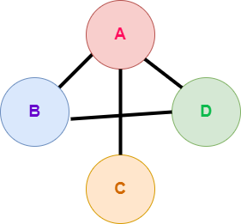


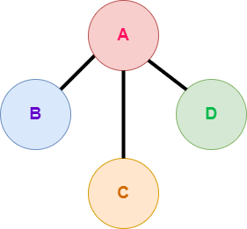
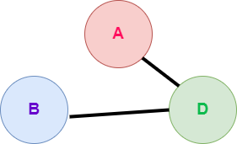




Message Passing Example
$$x_{1}$$
$$x_{2}$$
$$x_{4}$$
$$x_{3}$$
For example lets identify the 1-hop neighbours of the graph

Slide 21







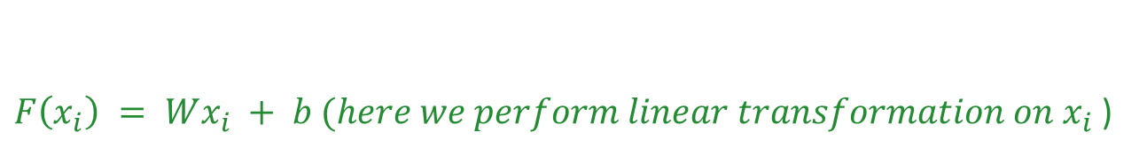






Now lets take Node A as the source node and perform message passing
Source node
Node A’s 1-hop neighbours
$$x_{2}$$
$$x_{3}$$
$$x_{4}$$
Respective Features
$$x_{2}$$
$$x_{3}$$
$$x_{4}$$
$$F\left(x_{i}\right)$$
$$h_{2}$$
$$h_{3}$$
$$h_{4}$$
$Here F can be MLP or RNN or simple affine function meaning simple linear tranformation will also work$.
Hence,
$F\left(x_{i}\right) = Wx_{i} + b (here we perform linear transformation on x_{i}$ )

Slide 22



Finally the transformed messges ($g_{i})$gets passed to the source node
$$g_{2}$$
$$g_{4}$$
$$g_{3}$$

Slide 23
Aggregate
Now that the messages from the 1-hop neighbour nodes have been passed into the source node.
We have to now find a way to combine these messages together (AGGREGATE).
But here is the catch, our aggregate function should be “Permutation Invariant”. This a key bias we will introduce to the GNNs. The justification is, that the nieghbour nodes should be taken in any order and shouldn’t effect the AGGREGATION.

Slide 24
Meaning, independent of the order we take the neighbours of the source node, the AGGREGATE function should produce the same results (Permutation Invariant)
Nothing tells the first order of nodes is better the other combination of node order, this is the reason for Permutation Invariant Aggregation function selection.

Slide 25
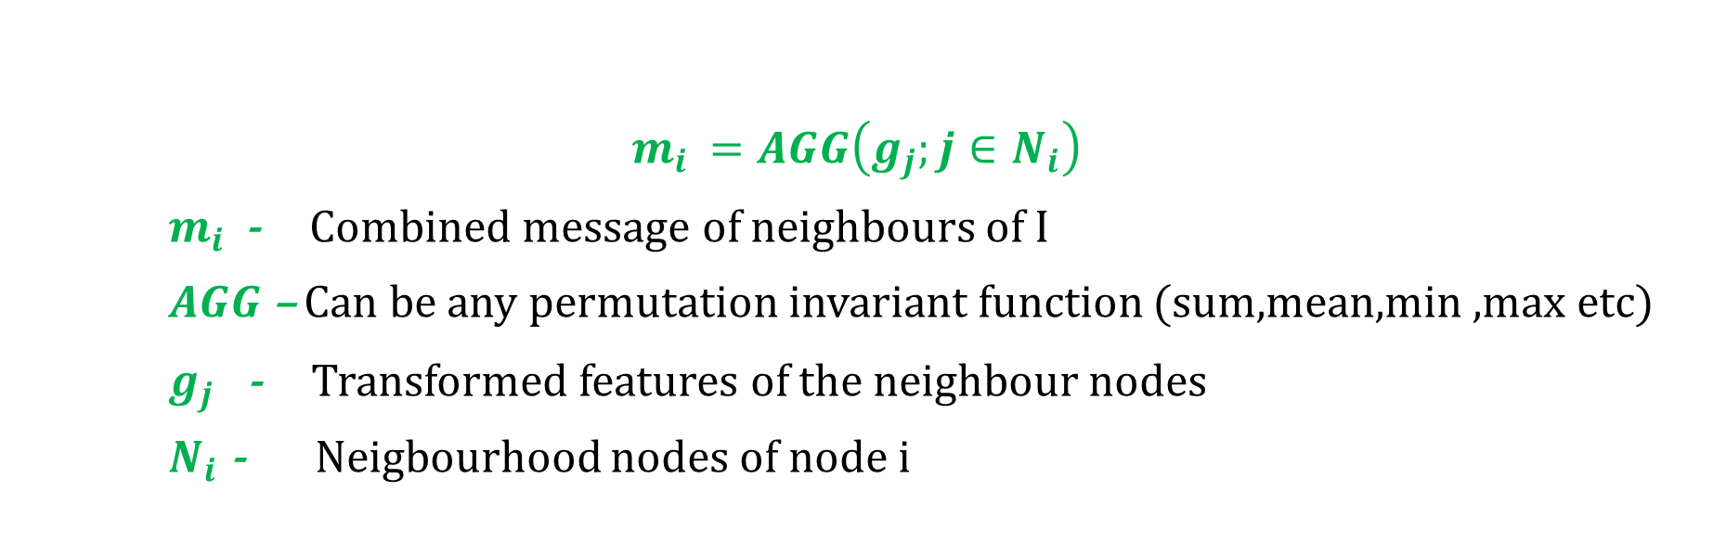
Some Famous Permutation Invariant Aggregation Functions
Summation ->1+2+3=3+2+1=2+1+3=6
Mean -> (1+2+3)/3=(3+2+1)/3=(2+1+3)=6/3=2
Min -> min(1,2,3)=min(3,2,1)=min(2,1,3) = 1
Max -> max(1,2,3)=max(3,2,1)=max(2,1,3) = 3
$$m_{i }=AGG\left(g_{j};j∈N_{i}\right)$$
$m_{i }$ - Combined message of neighbours of I
$AGG$ – Can be any permutation invariant function (sum,mean,min ,max etc)
$g_{j}$ - Transformed features of the neighbour nodes
$N_{i}$ - Neigbourhood nodes of node i
Hence lets define permutation invariant function AGG

Slide 26



To Recap
We perform message passing by transforming the features first.
$$g_{2}$$
$$g_{4}$$
$$g_{3}$$
Then we aggregate the messages by using a permutation invariant function
$$m_{i }=AGG\left(g_{j};j∈N_{i}\right)$$

Slide 27
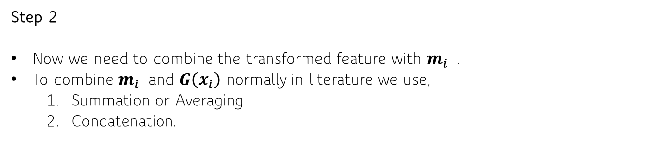
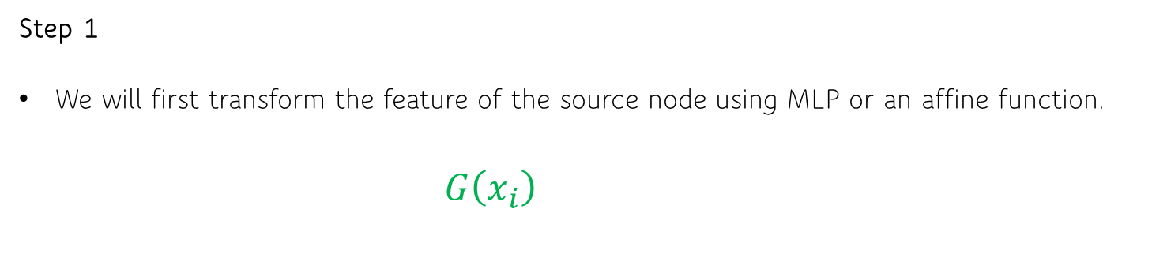
Update
Finally we need update the feature of the source node.
Here we need to utilize the incoming aggregated message as well for the update.
Step 1
We will first transform the feature of the source node using MLP or an affine function.
$$G\left(x_{i}\right)$$
Step 2
Now we need to combine the transformed feature with $m_{i }$ .
To combine $m_{i }$ and $G\left(x_{i}\right)$ normally in literature we use,
Summation or Averaging
Concatenation.

Slide 28
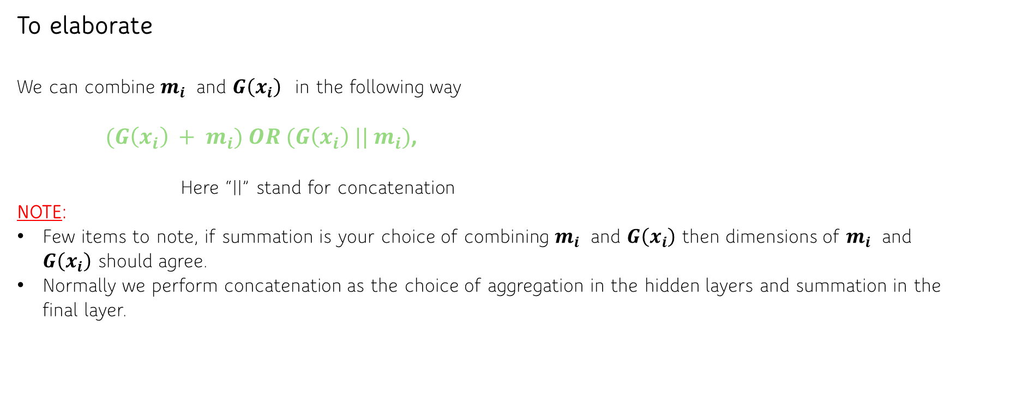
To elaborate
We can combine $m_{i }$ and $G\left(x_{i}\right)$ in the following way
$(G\left(x_{i}\right) + m_{i}) OR (G\left(x_{i}\right) || m_{i})$,
Here “||” stand for concatenation
NOTE:
Few items to note, if summation is your choice of combining $m_{i }$ and $G\left(x_{i}\right)$ then dimensions of $m_{i }$ and $G\left(x_{i}\right)$ should agree.
Normally we perform concatenation as the choice of aggregation in the hidden layers and summation in the final layer.

Slide 29

Step 3
Now that we have combined $m_{i }$ and $G\left(x_{i}\right)$ we will add the usual Neural Networks.
By that, we will pass the combination of $m_{i }$ and $G\left(x_{i}\right)$ into a MLP and then introduce a non-linearity to it.
$h_{i} =σ(H(G\left(x_{i}\right) , m_{i}))$
Where,
H = MLP
$σ$ = Non-linearity (eg:sigmoid, ReLu, Tanh etc..)

Slide 30





To sum up the operations in a GNN layer
Message Passing
Aggregate
Update
$$m_{i }=AGG\left(h_{j};j∈N_{i}\right)$$
$$h_{i} =σ(H(G\left(x_{i}\right) , m_{i}))$$
$$g_{2}$$
$$g_{4}$$
$$g_{3}$$
Well it’s done, one layer of GNN has been formulated!!
Note:
All these steps are performed on all the nodes in the graph simultaneously.

Slide 31







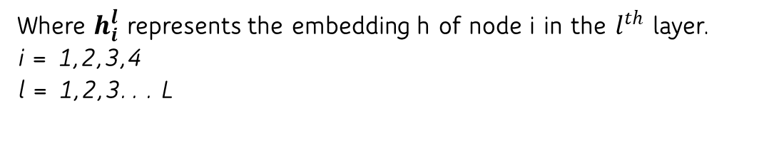









Stacking GNN layers together
GNN
Layer 1
GNN
Layer L
$$x_{1}$$
$$h_{1}^{1}$$
$$h_{1}^{L}$$
$$x_{4}$$
$$h_{2}^{1}$$
$$h_{4}^{1}$$
$$h_{2}^{L}$$
$$h_{4}^{L}$$
$$h_{1}^{L}$$
$$x_{2}$$
. . .
$$h_{2}^{L}$$
$$h_{3}^{L}$$
$$h_{4}^{L}$$
$$x_{3}$$
$$h_{3}^{1}$$
$$h_{3}^{L}$$
Final learned representation for the nodes A,B,C,D. This can be used for the downstream tasks.
Where $h_{i}^{l}$ represents the embedding h of node i in the $l^{th}$ layer.
i = 1,2,3,4
l = 1,2,3. . . L

Slide 32








Graph Neural Networks as an End to End Solution
Input Graph
Learned representations
Multilayer Perceptron(MLP)/RNN/Transformer/Autoencoders for downstream tasks like node classification, link prediction etc..
GNN
Layers
$$x_{1}$$
$$x_{2}$$
$$x_{4}$$
$$h_{1}^{L}$$
$$h_{2}^{L}$$
$$h_{3}^{L}$$
$$h_{4}^{L}$$
$$x_{3}$$

Slide 33
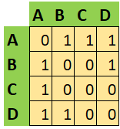




Achieving GNN layer operation using Adjacency Matrix (a simple approach)
$$x_{1}$$
$$x_{2}$$
$$x_{4}$$
$$x_{3}$$
Graph G
Adjacency matric for graph G

